Slide 1

Gradient Descent
Mean Squared Error (also called Cost Function)
Gradient Descent
Learning Rate
Input
x =[1,1,2,3,4,5]
Machine Learning
Output
y = [ 5, 7,9,11,13]
Use this to predict future values
Derived Equations
y = 2x +3
USA | Singapore
©DeepSphereAI.SG 2021 | Confidential & Proprietary

Slide 2
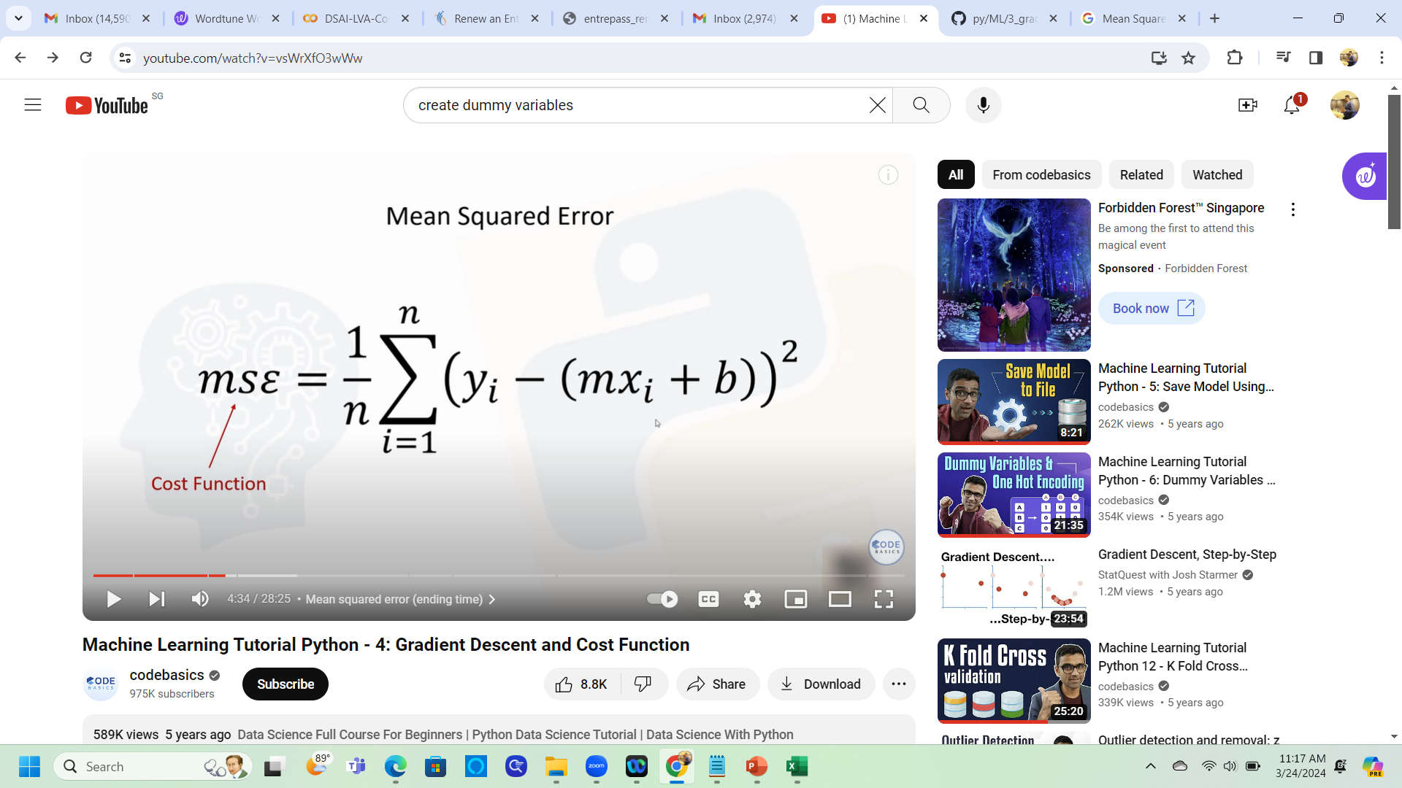
Gradient descent is an algorithm that finds the best-fit line for a given training data set with fewer interactions.
Output
Input
y = mx + c

Slide 3
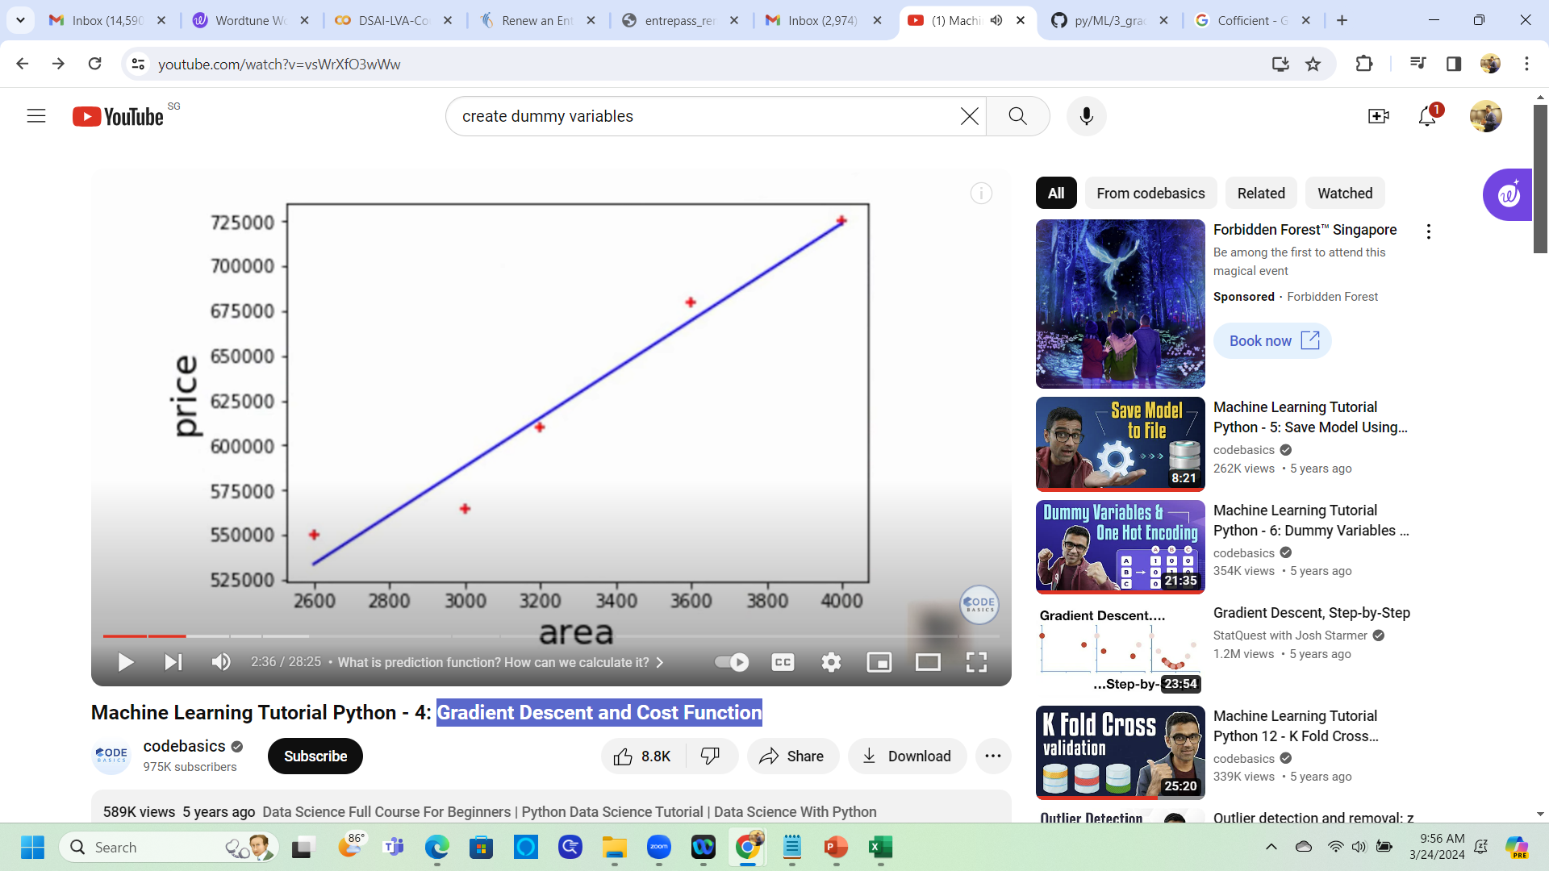
Gradient Descent
Rent
Best fit line
size

Slide 4
Gradient Descent
Location | Size | Rent_Price
Guindy | 2600 | 2500
Guindy | 3000 | 3500
Guindy | 3200 | 4500
Guindy | 3600 | 5500
Guindy | 4000 | 6500
Anna Nagar | 2600 | 2750
Anna Nagar | 2800 | 3850
Anna Nagar | 3300 | 4950
Anna Nagar | 3600 | 6050
Tambaram | 2600 | 7150
Tambaram | 2900 | 3025
Tambaram | 3100 | 4235
Tambaram | 3600 | 5445
Coefficient
Intercept
2600
3000
3200
3600
4000
2500
3500
4500
5500
6500
Rent Pike = 135.78 * Size + 180616.43
USA | Singapore
©DeepSphereAI.SG 2021 | Confidential & Proprietary

Slide 5
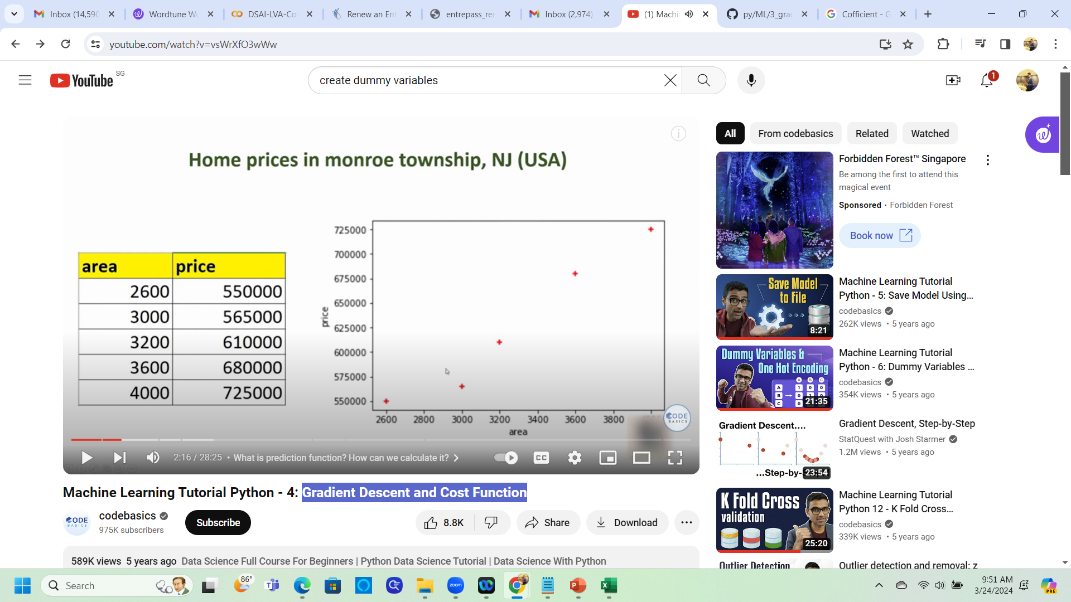
Gradient Descent
Given the input and output, how do we derive this equation?
Size
Rent
Rent
Coefficient
Intercept
size
Rent Pike = 135.78 * Size + 180616.43

Slide 6
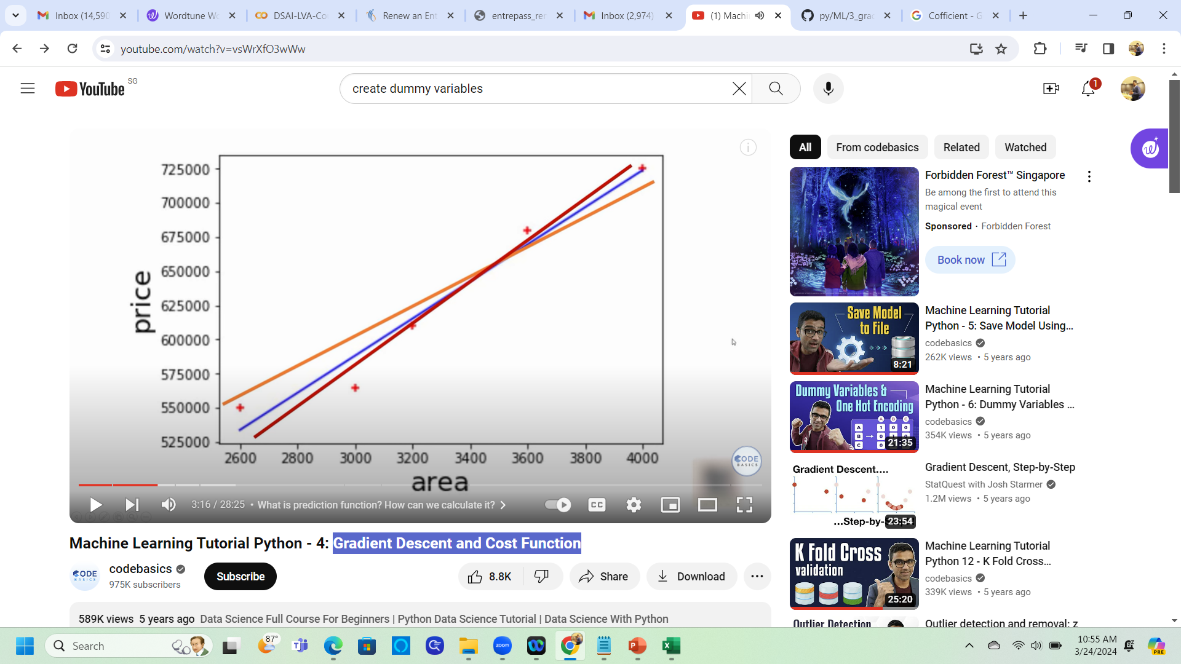
Gradient Descent
Rent
size
How do we know which is the
Best fit line?

Slide 7
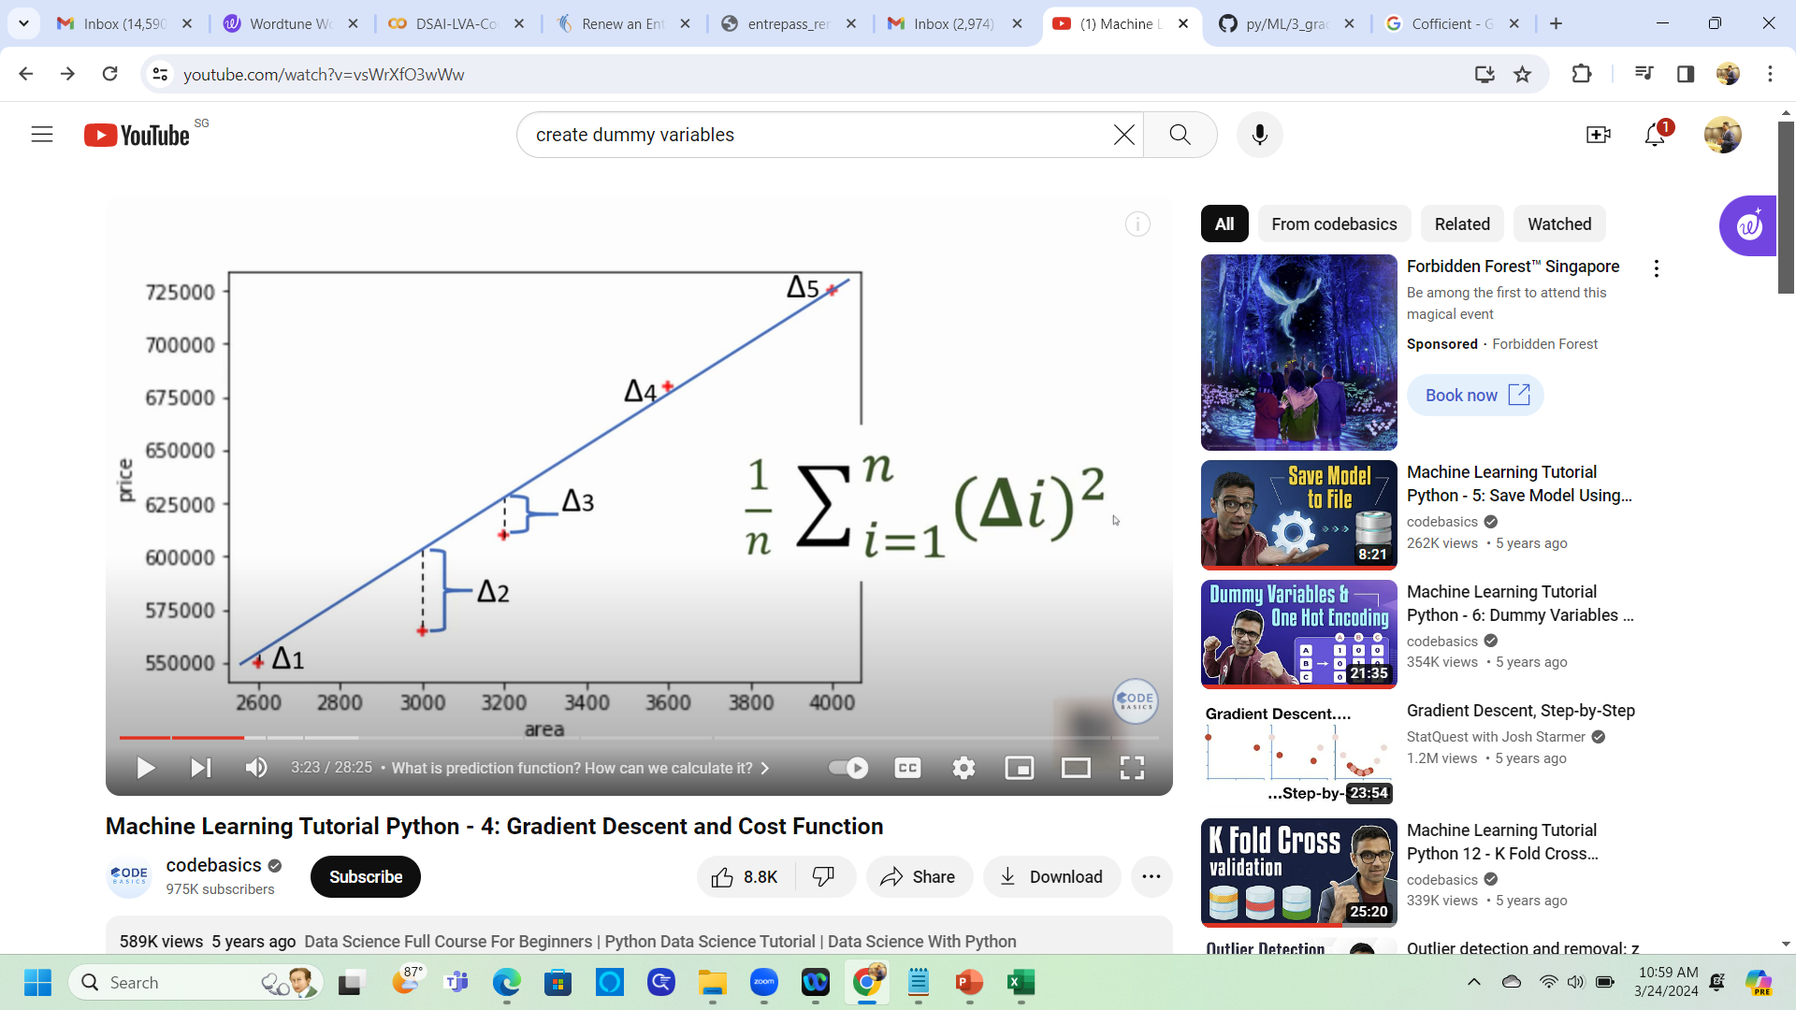
Gradient Descent
Delta refers to the distance between the predicted points and the line. The error points are basically here.
Rent
Avoid negative values
size
# of Data Points

Slide 8

Gradient Descent
Actual Data Points
Predicted Data Points
Using a mean squared error function as a cost function is common, but there are other types as well.
Mean Squared Error
Cost Function
Mean Squared Error

Slide 9
Gradient descent is an algorithm that finds the best-fit line for a given training data set with fewer interactions.
Output
Input
y = mx + c

Slide 10
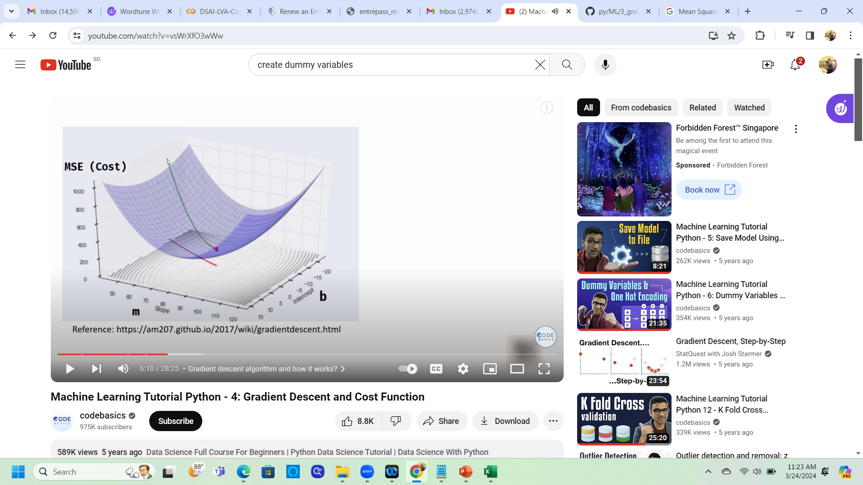
Gradient Descent
To begin, keep "m" and "b" as zero and calculate the cost. As you can see in this example, the cost is 1000. After reducing the values of "m" and "b", calculate the cost.
To begin, keep "m" and "b" as zero and calculate the cost. As you can see in this example, the cost is 1000. After reducing the values of "m" and "b", calculate the cost.

Slide 11
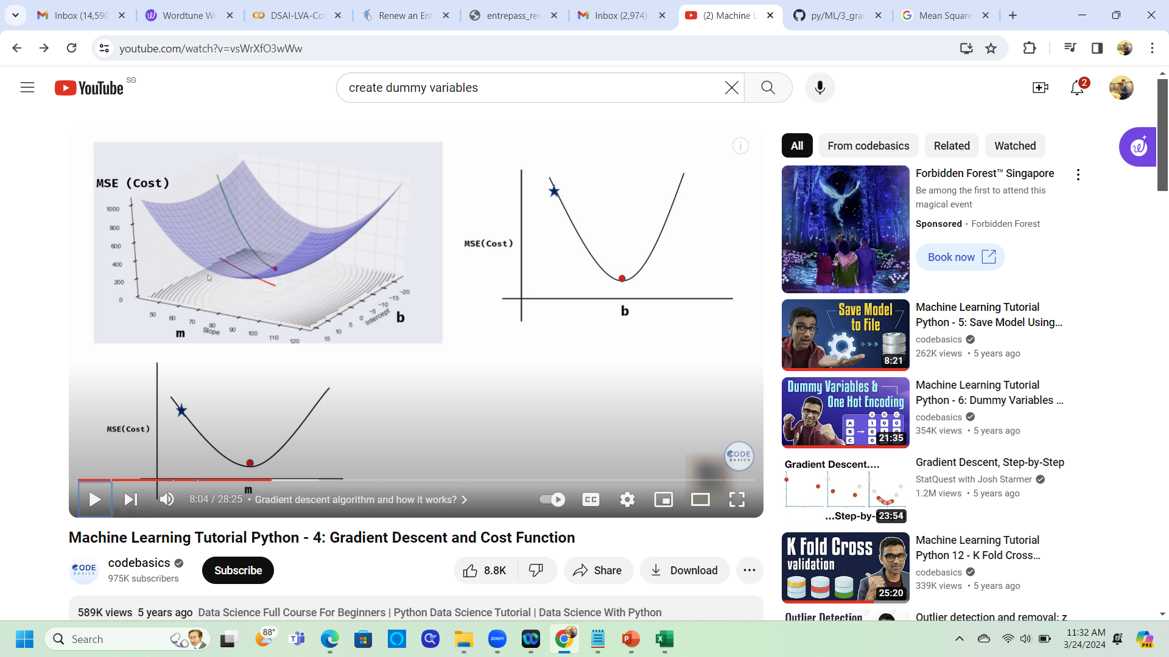
Gradient Descent
Starting Point
In each iteration, "m" and "b" will change and the MSE(Cost) will decrease
End Point

Slide 12
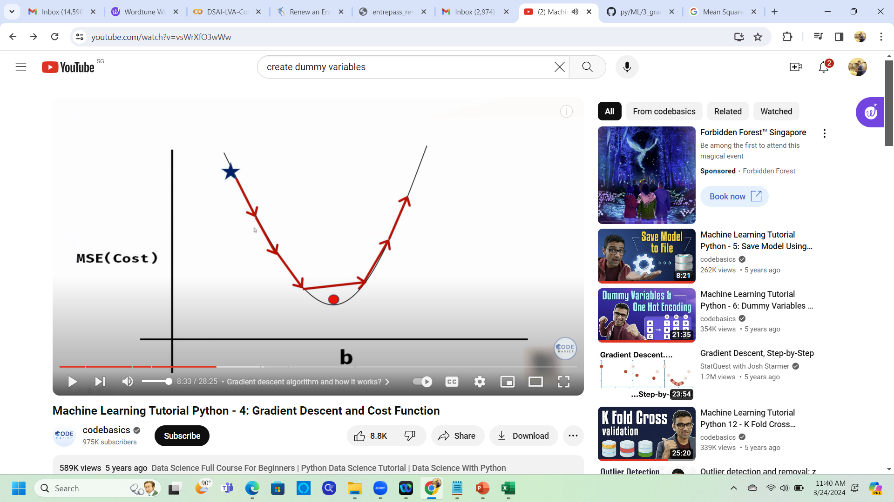
Gradient Descent
Big steps/intervals
Big steps/intervals
b
The Gradient Descent may not coverage

Slide 13

Gradient Descent
Smaller steps/intervals
Additional Math Reading
Slope
Derivative
Partial Derivative
Gives Direction
A learning rate is the rate at which learning occurs
The Gradient Descent may be coverage

Slide 14
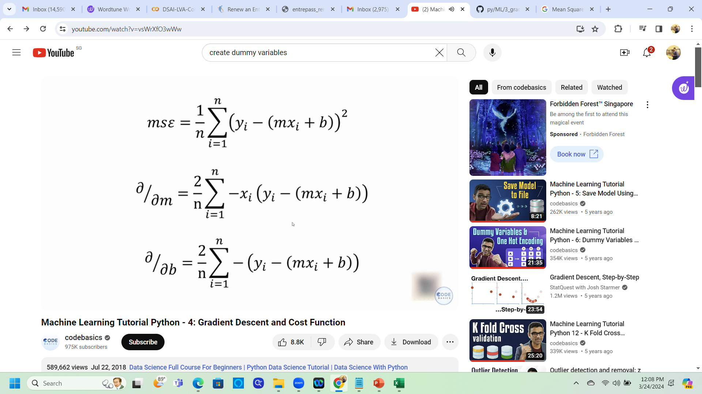
Gradient Descent
Mean Squared Error
This gives us the direction through slope
Partial Derivative of “m”
Partial Derivative of “b”
Getting direction

Slide 15

Gradient Descent
Learning Rate
Partial Derivative
step size at each iteration while moving toward a minimum of a loss function

Slide 16

Gradient Descent
Learning Rate
step size at each iteration while moving toward a minimum of a loss function

